Slide 1

Project Progress Summary
MSc Computer Science Summer Project – individual project
Supervisor: Professor Kerstin Eder
Speaker: Qi Zhao

Slide 2
01
Background
02
Transfer learning research
Contents
03
Web dashboard
04
Challenges

Slide 3
“ PART ONE”
Project Background

Slide 4
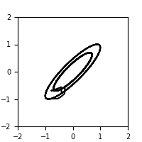
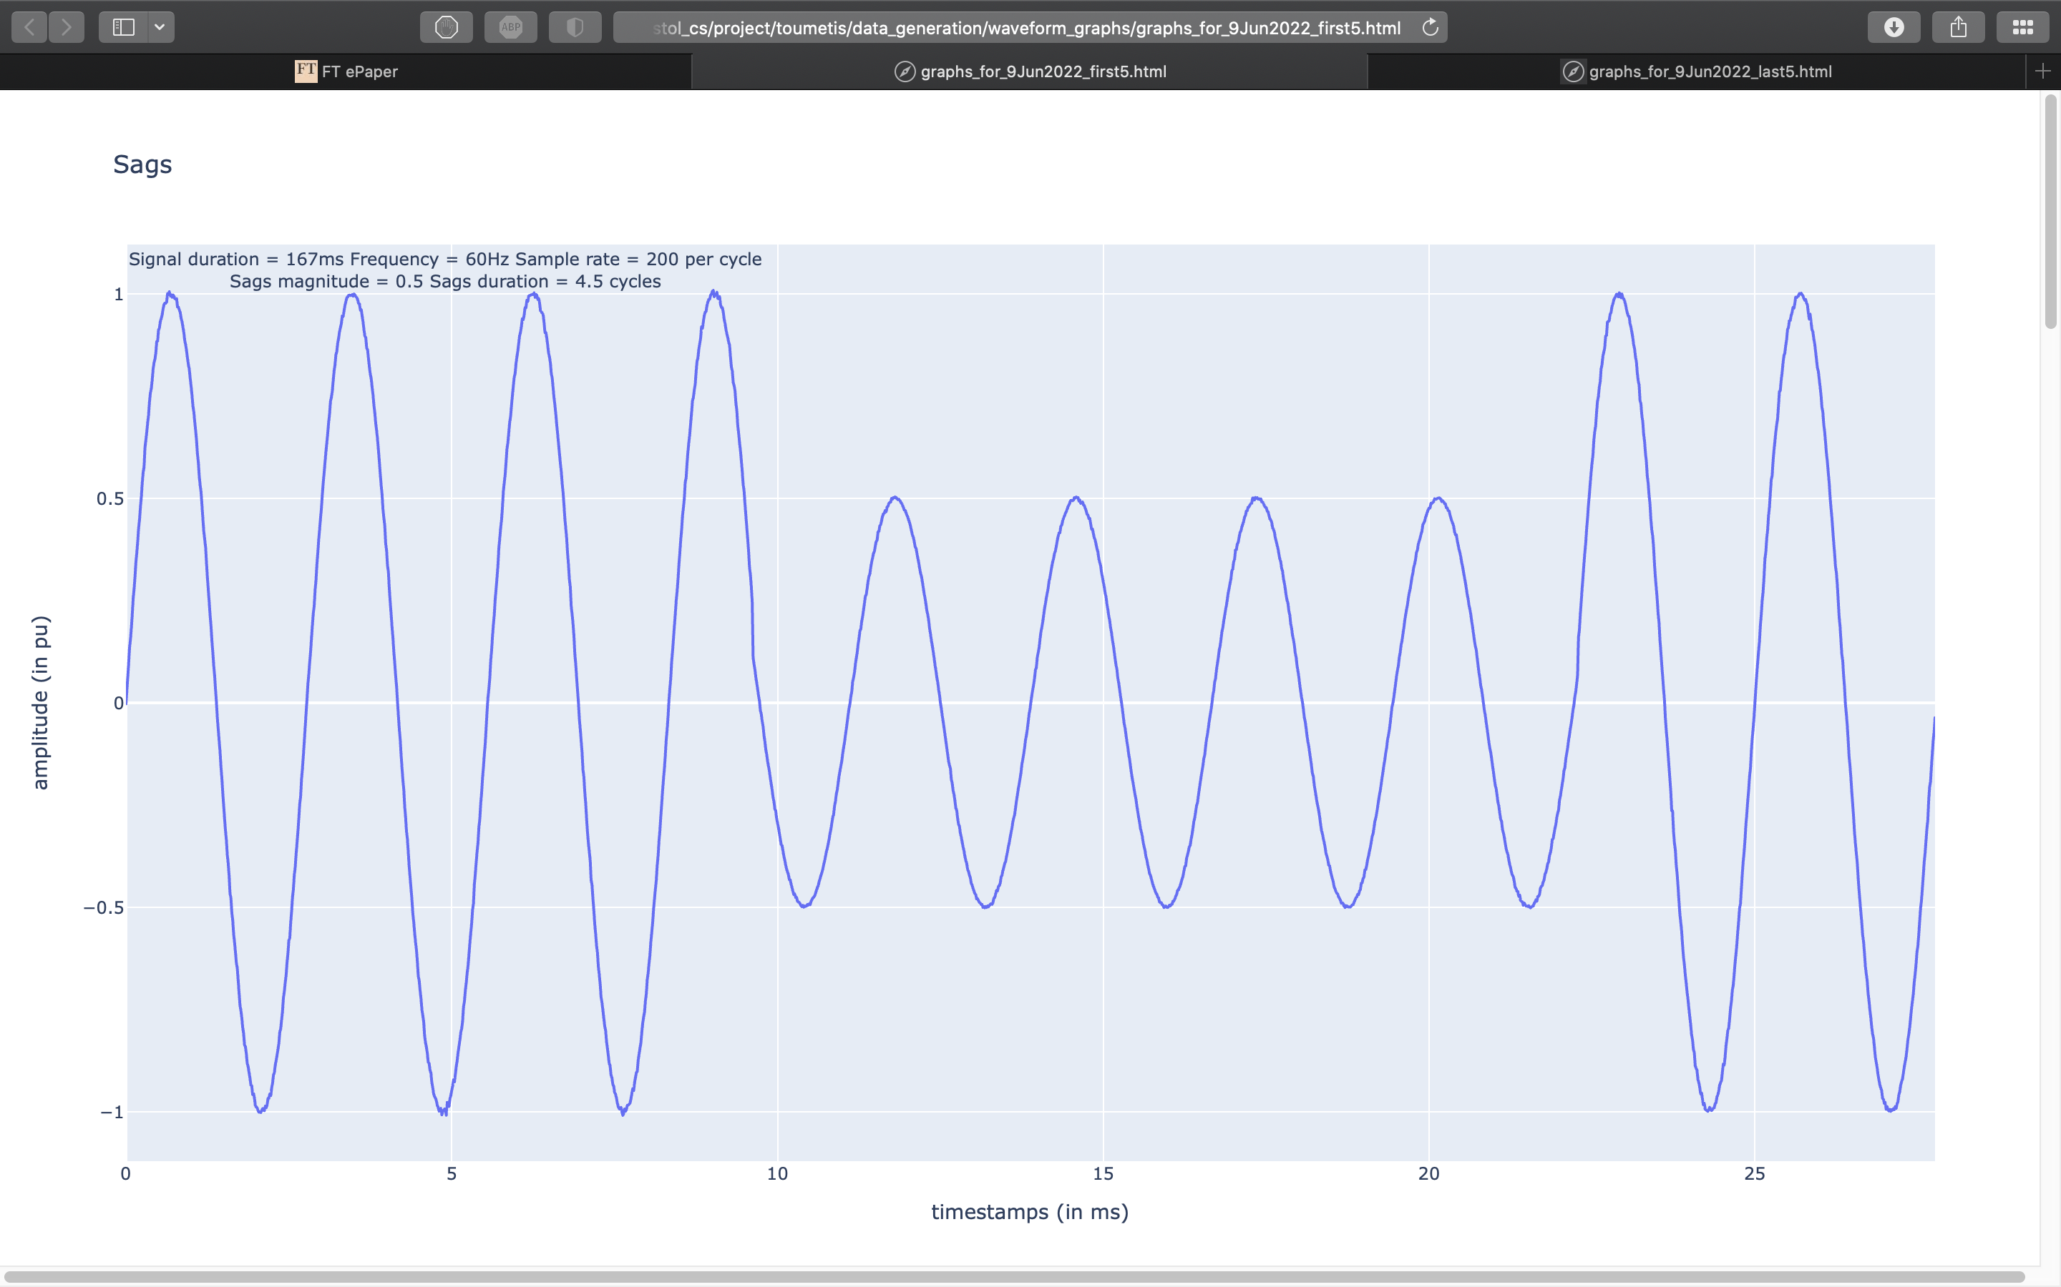
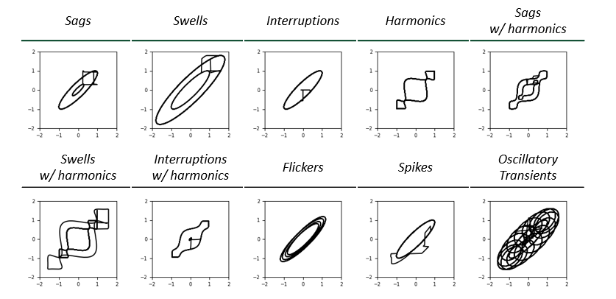
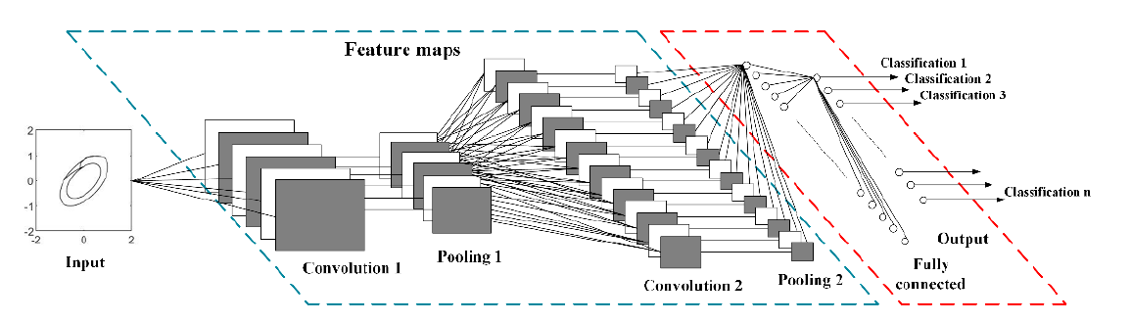
Background
Transfer learning
Web dashboard
Challenge
Team project workflow:
Step 1
Signal waveforms as 1D timeseries data
2D Phase Space Reconstruction (PSR) images
Step 2
Step 3
Source: Cai, Kewei, et al. "Classifying power quality disturbances based on phase space reconstruction and a convolutional neural network." Applied Sciences 9.18 (2019): 3681.
Predict 10 power quality disturbance
Step 4 (next slide)

Slide 5
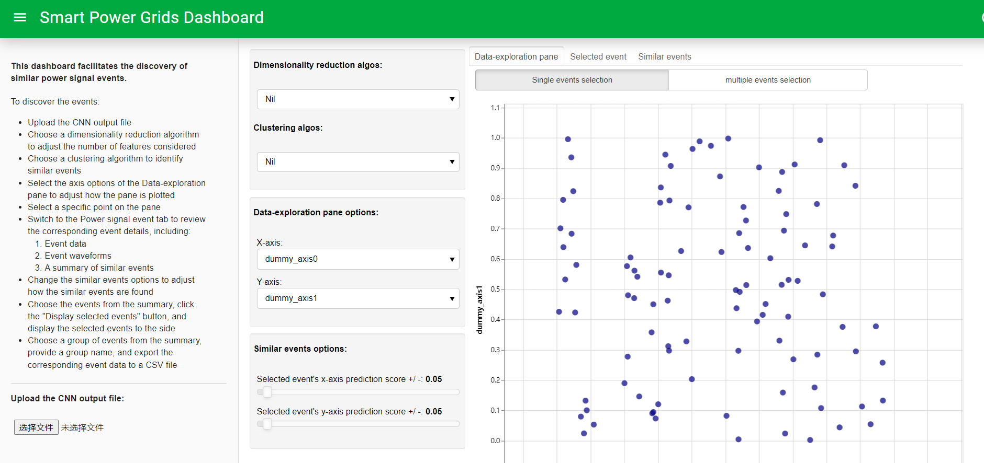
Background
Transfer learning
Web dashboard
Challenge
Team project workflow:
Step 4
Power quality disturbance prediction results
Step 5
Data visualization on an interactive web dashboard

Slide 6
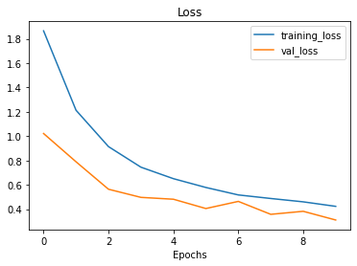
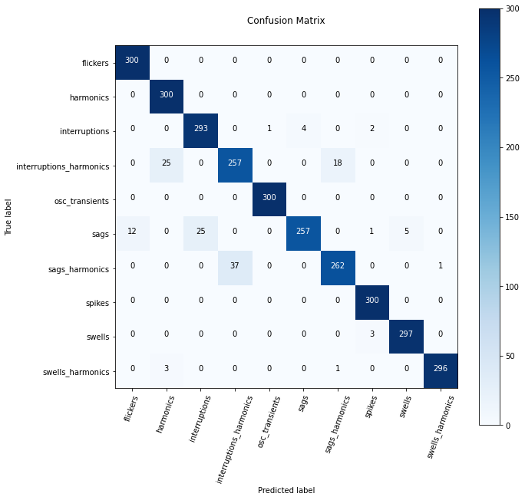
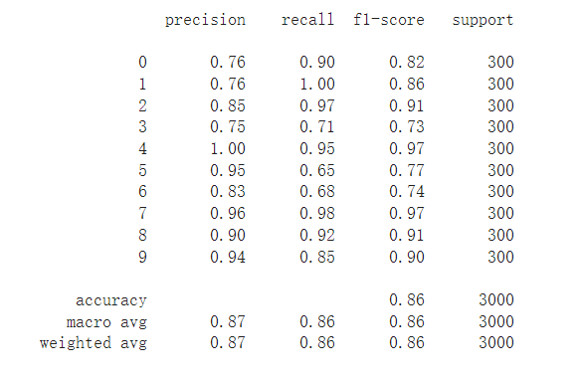
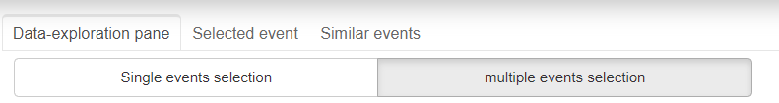

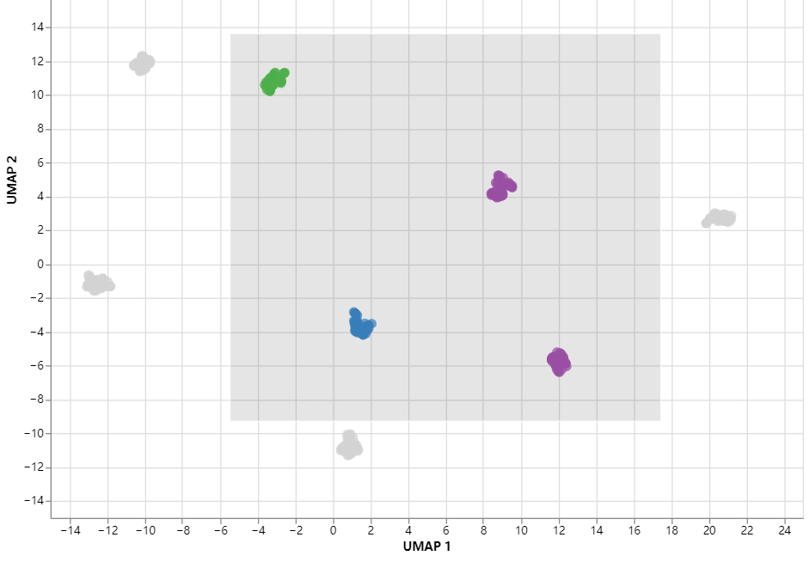
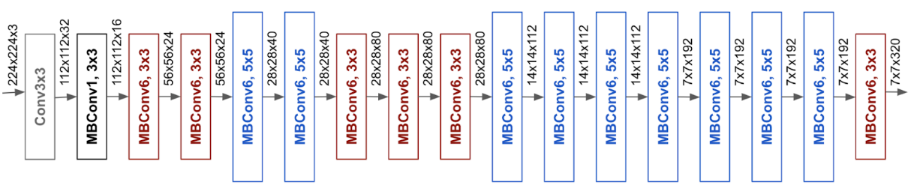
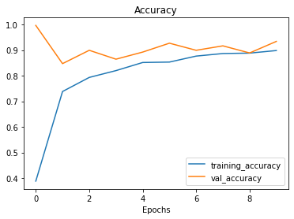
Background
Transfer learning
Web dashboard
Challenge
Individual project contents（until 26 October）:
Part one: Transfer learning
Constructed different transfer learning models.
Compare transfer learning models’ accuracy with original models.
Confusion matrix
Macro F1 scores
Loss / validation curves
Base model : 2 convolution layers, 2 pooling layers, 1 fully connect layer.
Output
Part two: Web dashboard
Add more interactive features to the original web dashboard
Improve data loading and processing efficiency.
Input
Transfer learning model architecture (EfficientNetB0): 237 layers
Source :https://ai.googleblog.com/2019/05/efficientnet-improving-accuracy-and.html

Slide 7
“ PART TWO”
Transfer learning research

Slide 8
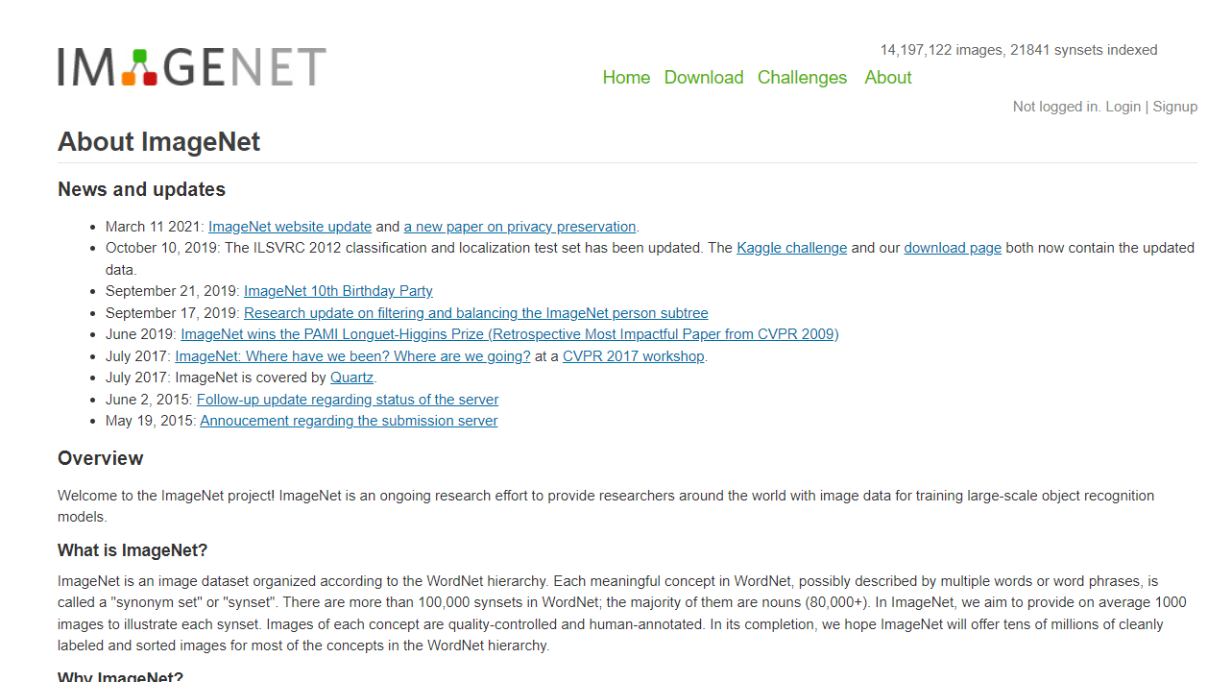
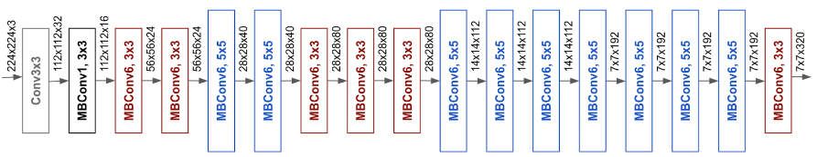
Background
Transfer learning
Web dashboard
Challenge
Transfer learning benefits:
Can leverage an existing neural network architecture proven to work on similar problems.
Can leverage a working neural network architecture that has already learned patterns on similar data to our own. This often results in achieving great results with fewer custom data.

Slide 9
Background
Transfer learning
Web dashboard
Challenge
Transfer learning workflow:
Changes
Stay same
Output layer(shape = 1000)
10
10
Layer 237
Layer 237
Changes
(Unfrozen)
Layer 237
Stay same
(frozen)
Layer 236
Layer 236
Layer 236
Working
architecture
Layer 2
Layer 2
Stay same
(frozen)
Layer 2
Input layer
Input layer
Input layer
Changes
Might change
Large dataset (e.g. ImageNet)
Small custom dataset
(e.g. 10% ten power quality disturbances)
Might use different datasets
(e.g. 1% ten power quality disturbances)
Original Model
Feature extraction
Fine-tuning

Slide 10
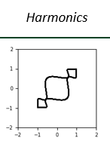
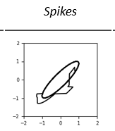
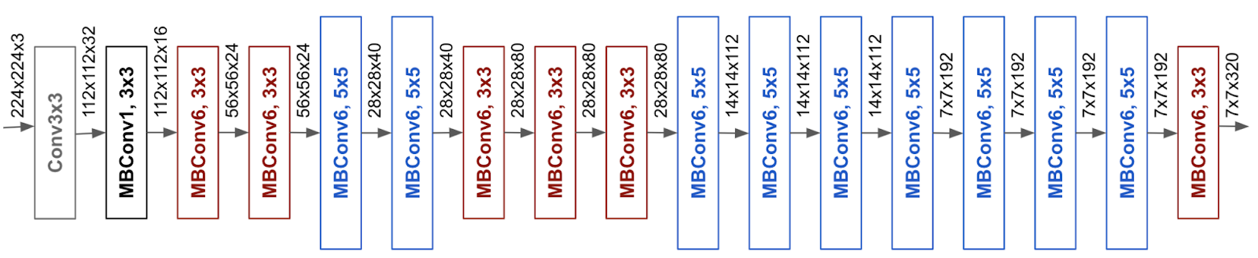
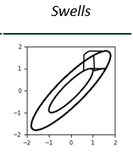
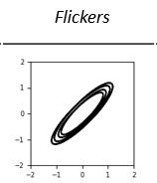
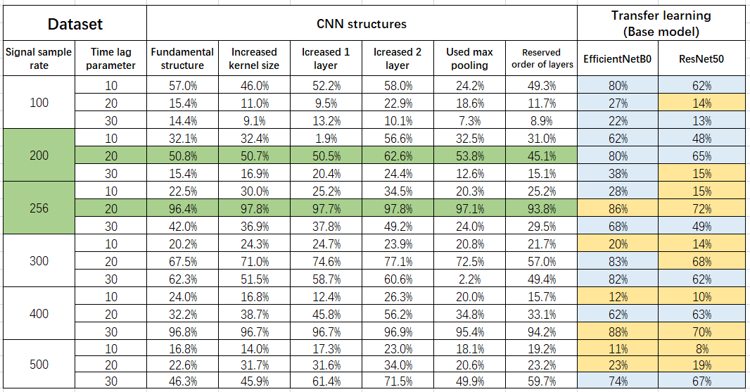
Background
Transfer learning
Web dashboard
Challenge
Feature extraction :
Stay same( frozen, pre-trained on ImageNet )
Changes
Output:
10 classes prediction
Input
EfficientNetB0 architecture
Source :https://ai.googleblog.com/2019/05/efficientnet-improving-accuracy-and.html
The accuracy is related to the parameter of the training dataset as well as different pre-trained models.
10% training dataset can produce fairly good accuracy.
The results of feature extraction experiments

Slide 11
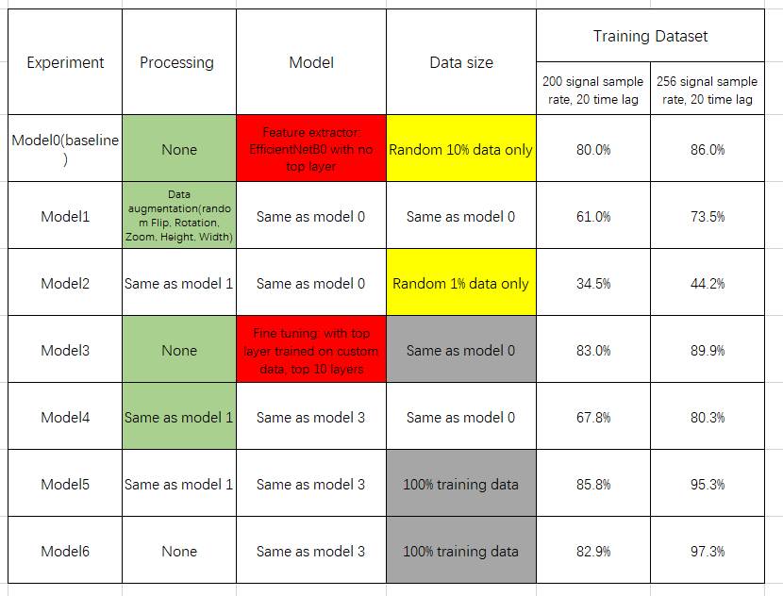
Background
Transfer learning
Web dashboard
Challenge
Fine-tuning :
Changes
(unfrozen, get fine-tuned on custom data)
Data augmentation
Stay same( frozen, pre-trained on ImageNet )
Changes
Output:
10 classes prediction
Input
EfficientNetB0 architecture
Source :https://ai.googleblog.com/2019/05/efficientnet-improving-accuracy-and.html
Why?
Data augmentation doesn’t improve the accuracy of models in the research.
Pre-trained models with fine-tuning indicate better results.
Too small training datasets may lead to
poor training results.
The accuracy is improved if we increase the amount of training data.
The results of fine-tuning experiments

Slide 12
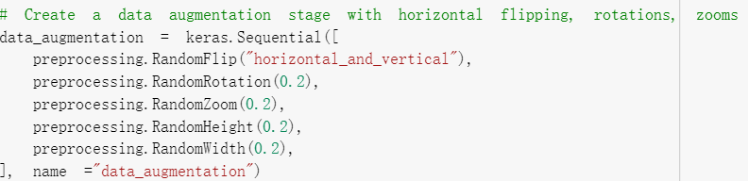
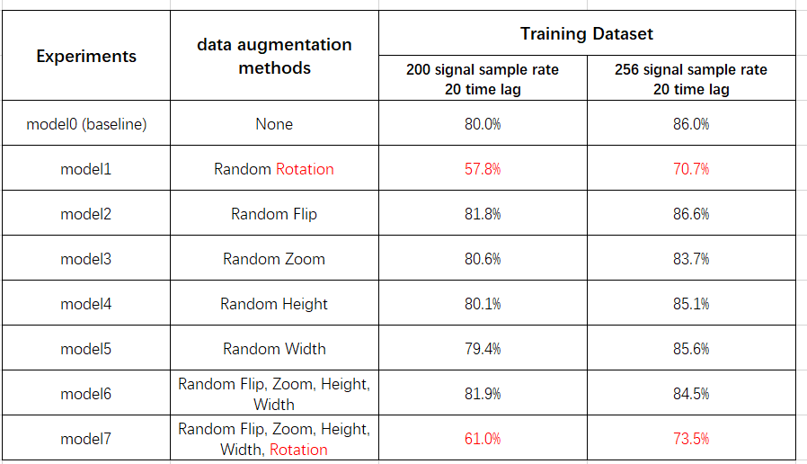
Background
Transfer learning
Web dashboard
Challenge
Data augmentation analysis:
The data augmentation transformations we used:
RandomFlip - flips image on the horizontal or vertical axis.
RandomRotation - randomly rotates images by a specified amount.
RandomZoom - randomly zooms into an image by a specified amount.
RandomHeight - randomly shifts image height by a specified amount.
RandomWidth - randomly shifts image width by a specified amount.
Five ways to
augment data
Why?
Random rotation dramatically reduces the model accuracy.
The other four methods have little effect on improving the models’ accuracy
The results of data augmentation experiments

Slide 13
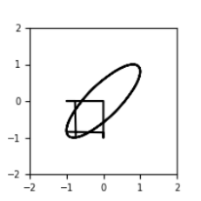
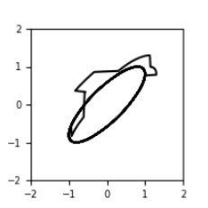
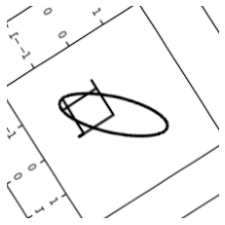
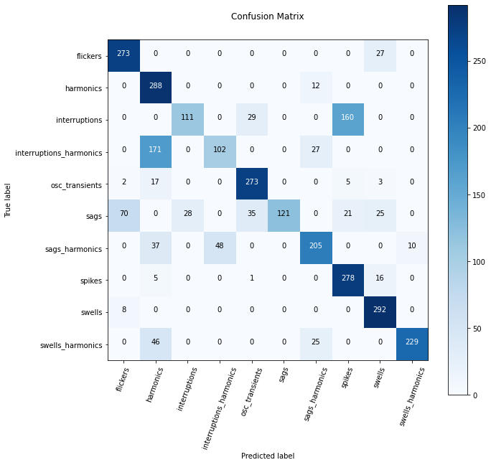
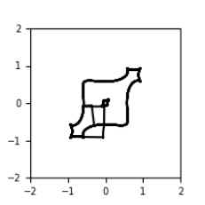
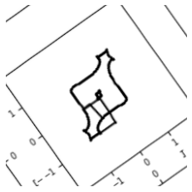
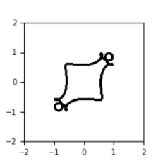
Background
Transfer learning
Web dashboard
Challenge
Random Rotation Analysis:
Wrong
Prediction
Rotate
Random interruption signal
Random spikes signal
Wrong
Prediction
Rotate
Random interruption_harmonics signal
Random harmonics signal
Confusion matrix of the data augmented model(only rotate data)
Notes:
本来预测的信号类型的图像就和本身的信号类型的图像相似，且可能rotation改变了原来图像的斜率，形状等等，因此产生了模型的错误预测结果。前面想错了，因为改变高度和宽度一样会改变
斜率。

Slide 14
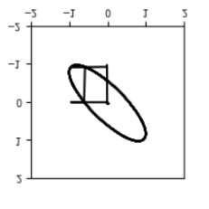

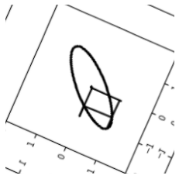
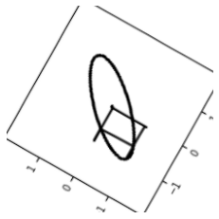
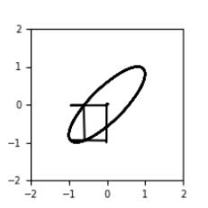
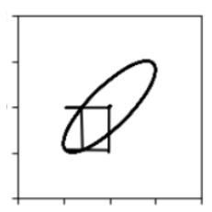
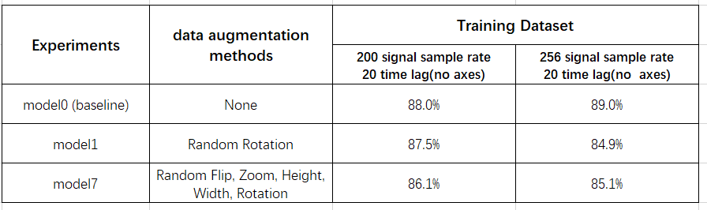
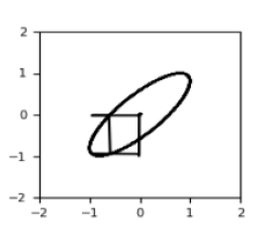

Background
Transfer learning
Web dashboard
Challenge
Five ways to augment data:
Flip
Rotate
Change fill mode
Remove axes
F1 score increases
from 57.8% to 62.0%
Retrain
Zoom
Original interruption signal
Shift height
Shift width
The results of data augmentation experiments
Notes:
先考虑了可能是改变斜率，后来发现可能是数轴问题，然后去数轴考虑两种方法，用第二种方法做了六个实验，证明数据增强在本问题中作用不大。数据增强可以增加训练数据量和数据多样性，解决比如拍的照片角度不同的问题，我们研究的是二维图像，不存在类似问题。另外改变的形状斜率反而会干扰模型的预测。数据增强综上所述不一定有正向作用，要具体情况具体分析。

Slide 15
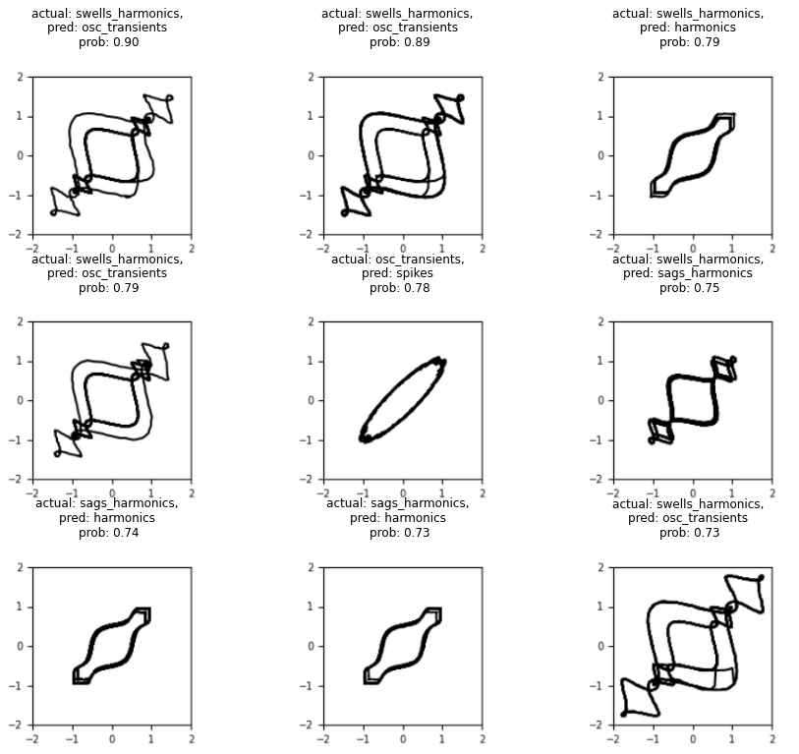
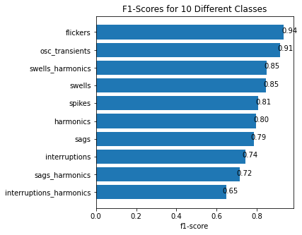
Background
Transfer learning
Web dashboard
Challenge
Evaluate performance of models:
F1 scores of 10 different classes, based on the basic model0
The 9 most wrong predictions
(where the ground truth doesn't match the prediction with the highest max prediction probabilities. ).
Notes:
根据第一个图片可以看出不同模型对于不同干扰类别的预测精度不同，从第二个图片可以看出最错误的预测也没有集中在一个类别里，这样我们没有办法通过只调整一个类别的训练数据，比如增加训练数据量，来增加模型整体精度，因此我们考虑把几种模型合在一起预测。

Slide 16
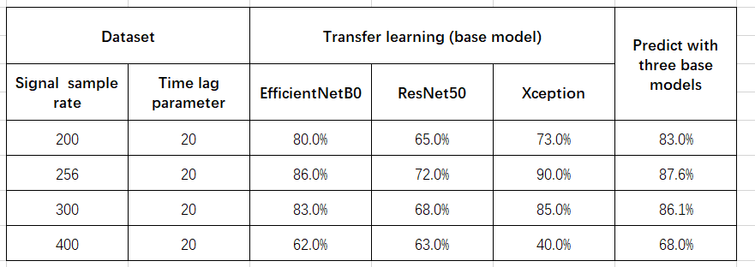
Background
Transfer learning
Web dashboard
Challenge
Predict with three trained models:
F1 scores of different experiments
Predicting datasets with three models together shows better performance than using a single model.

Slide 17
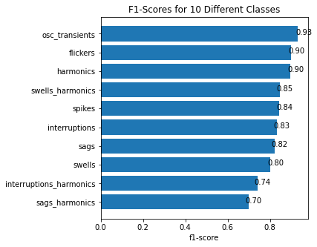
Background
Transfer learning
Web dashboard
Challenge
Predict with three trained models:
Predict with a base model.
Predict with three models together.
The accuracy of each class is generally improved.

Slide 18
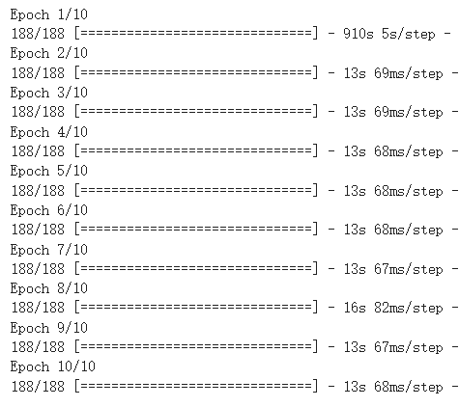
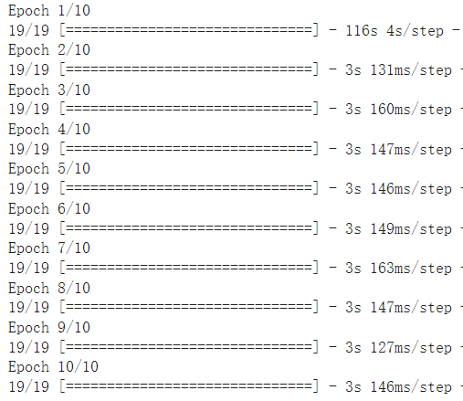
Background
Transfer learning
Web dashboard
Challenge
More transfer learning analysis :
Fewer training data(10% of original data), faster training.

Slide 19
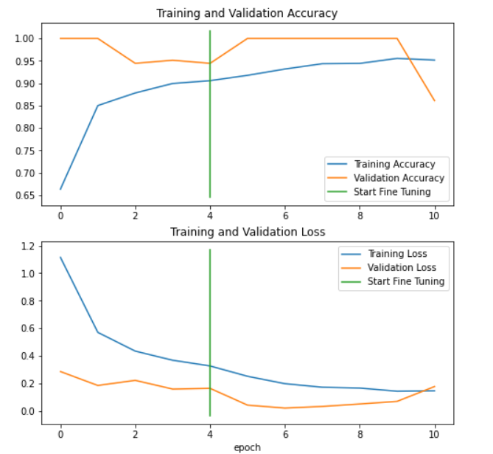
Background
Transfer learning
Web dashboard
Challenge
More transfer learning analysis:
Sometimes, a large amount of training data(100% of original data) or too many training epochs may cause overfit.

Slide 20
Background
Transfer learning
Web dashboard
Challenge
Conclusion of transfer learning:
Less training data
faster training time
Fairly good accuracy, especially using suitable base models and datasets.
Fine-tuning a part of layers can improve the accuracy of models.
Data augmentation has little effect on improving the models’ accuracy in the research.///(不一定)

Slide 21
“ PART THREE”
Web dashboard

Slide 22
Background
Transfer learning
Web dashboard
Challenge

Slide 23
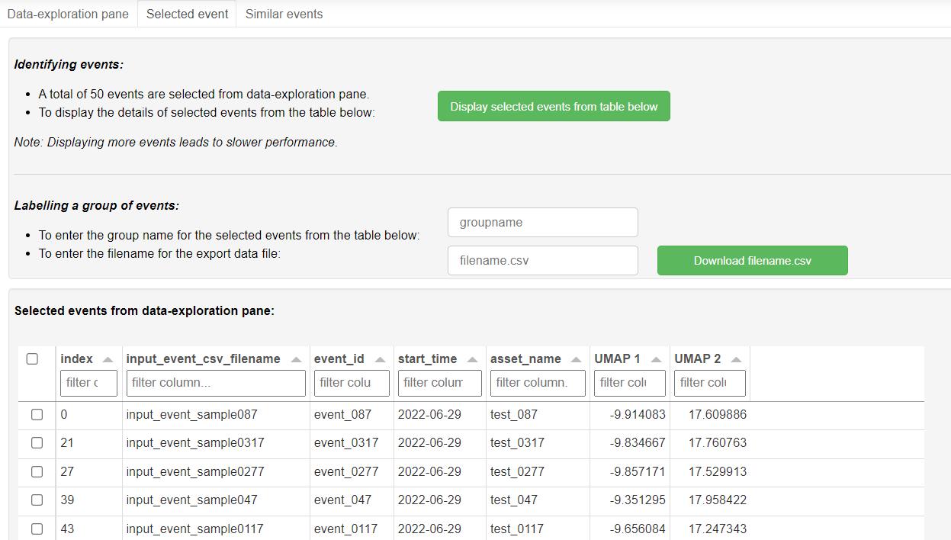
Background
Transfer learning
Web dashboard
Challenge
Selected events page:
Function to display the
selected events
Find out target events using filters
Function to label and export the selected events

Slide 24
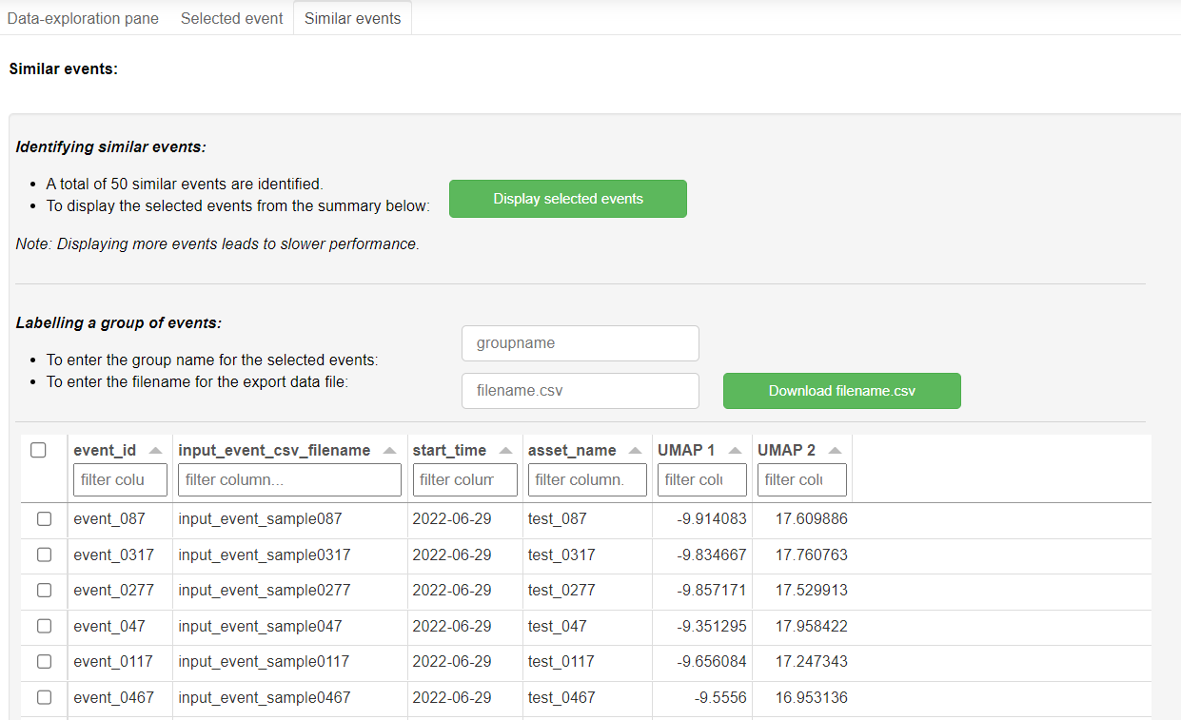
Background
Transfer learning
Web dashboard
Challenge
Similar events page:
Function to display the
selected similar events
Find out target events using filters
Function to label and export the selected similar events

Slide 25
Background
Transfer learning
Web dashboard
Challenge
Improving web performance attempts:
Caching
Layout rendering
Throttling
More treads to run our code
asynchronous functions(didn’t finish until 26 October)
Better performance when loading data from disk or over a network connection
Change rendering orders to speed up layout rendering.
When using sliders, parameters are updated only when the user releases the slider instead of updating continuously as the slider is dragged
Distribute processing across multiple threads.
Notes:
最后的演讲这页需要改

Slide 26
Background
Transfer learning
Web dashboard
Challenge

Slide 27
Background
Transfer learning
Web dashboard
Challenge

Slide 28
Background
Transfer learning
Web dashboard
Challenge

Slide 29
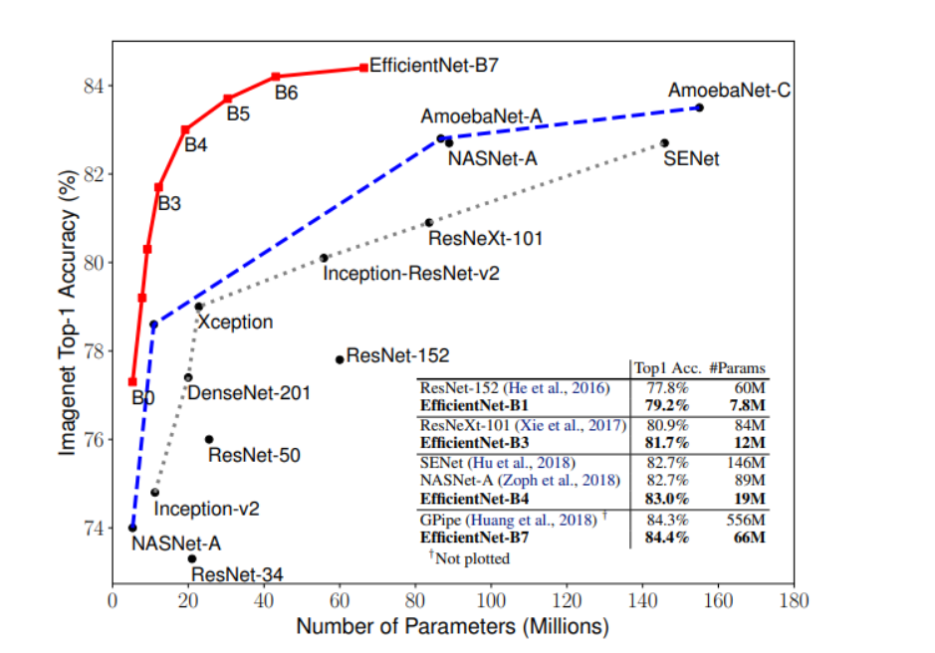
Convolutional Neural Network models
Source :https://ai.googleblog.com/2019/05/efficientnet-improving-accuracy-and.html

Slide 30
“ PART FOUR”
Challenges
Please enter the relevant text content here. Operation method: select all the text in this paragraph with the mouse, and enter the text directly to replace it. The text format will not change.

Slide 31
Thanks for watching

